Slide 1
Ethics in Information Technology
Chapter 3
Cyberattacks and Cybersecurity
George W. Reynolds

Slide 2
Learning Objectives
Why are computer incidents so prevalent, and what are their effects?
What can be done to implement a strong security program to prevent cyberattacks?
What actions must be taken in the event of a successful security intrusion?

Slide 3
The Threat Landscape
Making decisions regarding IT security involves weighing complex trade-offs:
How much effort and money should be spent to safeguard against computer crime?
What should be done if recommended IT security safeguards make conducting business more difficult, resulting in lost sales and increased costs?
If a firm is a victim of a cybercrime, should it pursue prosecution of the criminals, maintain a low profile to avoid negative publicity, inform affected customers, or take some other action?

Slide 4
Why Computer Incidents Are So Prevalent, Part 1
Increasing complexity increases vulnerability
As more devices are added, the number of network entry points grows, increasing security risks
Expanding and changing systems introduce new risks: IT organizations must:
Keep up with technological change
Perform ongoing security assessments
Implement approaches for dealing with new risks
Increasing prevalence of BYOD policies
Bring your own device (BYOD): Business policy that permits employees to use their own mobile devices to access company computing resources

Slide 5
Why Computer Incidents Are So Prevalent, Part 2
Growing reliance on commercial software with known vulnerabilities
Exploit: An attack on an information system that takes advantage of a particular system vulnerability
Zero-day attack: Takes place before the security community or software developer becomes aware of and repairs a vulnerability
Increasing sophistication of those who would do harm

Slide 6
Classifying Perpetrators of Computer Crime
Type of Perpetrator | Description
Black hat hacker | Someone who violates computer or Internet security maliciously or for illegal personal gain
Cracker | An individual who causes problems, steals data, and corrupts systems
Malicious insider | An employee or contractor who attempts to gain financially and/or disrupt a company’s information systems
Industrial spy | An individual who captures trade secrets to gain an unfair competitive advantage
Cybercriminal | Someone who attacks a computer system for financial gain
Hacktivist | An individual whose goal is to promote a political ideology
Cyberterrorist | Someone who attempts to destroy government infrastructure, financial institutions, and other corporations, utilities, and emergency response units

Slide 7
Types of Exploits, Part 1
Ransomware: Malware that stops you from using your computer or accessing your data until you meet certain demands, such as paying a ransom
Virus: A piece of programming code, disguised as something else, that causes a computer to behave in an unexpected and usually undesirable manner
Worm: A harmful program that resides in the active memory of the computer and duplicates itself
Trojan horse: A program in which malicious code is hidden inside a seemingly harmless program
Logic bomb: Executes when triggered by a specific event

Slide 8
Types of Exploits, Part 2
Blended threat: An attack that combines the features of a virus, worm, Trojan horse, and other malicious code into a single payload
Spam: The use of email systems to send unsolicited email to large numbers of people
Controlling the Assault of Non-Solicited Pornography and Marketing (CAN-SPAM) Act: Makes spam legal with certain restrictions—the email must include: a real return address, a label specifying that it is an ad or solicitation, and a way for recipients to opt out of future emails
CAPTCHA (Completely Automated Public Turing Test to Tell Computers and Humans Apart): Software that generates and grades tests that humans can pass but computer programs cannot

Slide 9
Types of Exploits, Part 3
Distributed denial-of-service (DDoS) attack: An attack that takes over computers via the Internet, causing them to flood a target site with demands for data and other small tasks
Rootkit: A set of programs that enables its user to gain administrator-level access to a computer without the end user’s consent or knowledge
Advanced persistent threat (APT): An attack in which an intruder gains access to a network and stays there—undetected—with the intention of stealing data over a period of weeks or months

Slide 10
Types of Exploits, Part 4
Phishing: The act of fraudulently using email to try to get the recipient to reveal personal data
Spear phishing: A variation of phishing in which the phisher sends fraudulent emails to an organization’s employees
Smishing: A variation of phishing in which the victims receive a legitimate-looking text message telling them to call a specific phone number or log on to a website
Vishing: A variation of phishing in which the victims receive a voice-mail message telling them to call a phone number or access a website

Slide 11
Types of Exploits, Part 5
Cyberespionage: The deployment of malware that steals data from government agencies, military contractors, political organizations, or manufacturing firms
Cyberterrorism: The intimidation of a government or a civilian population by using IT to disable critical national infrastructure
Department of Homeland Security (DHS): A federal agency whose goal is to provide for a safer, more secure America, resilient against terrorism and other potential threats
U.S. Computer Emergency Readiness Team (US-CERT): A DHS and public/private sector partnership; serves as a clearinghouse for information on new security threats

Slide 12
Federal Laws for Prosecuting Computer Attacks, Part 1
Computer Fraud and Abuse Act
Addresses fraud and related activities in association with computers, including:
Accessing a computer without authorization
Transmitting code that causes harm to a computer
Trafficking of computer passwords
Threatening to cause damage to a protected computer
Fraud and Related Activity in Connection with Access Devices Statute
Covers false claims regarding unauthorized use of credit cards

Slide 13
Federal Laws for Prosecuting Computer Attacks, Part 2
Stored Wire and Electronic Communications and Transactional Records Access Statutes
Focuses on unlawful access to stored communications to obtain, alter, or prevent authorized access to a wire or electronic communication while it is in electronic storage
USA Patriot Act
Defines cyberterrorism and associated penalties

Slide 14
CIA Security Triad
CIA security triad: The confidentiality, integrity, and availability of systems and data
IT security practices focus on the CIA security triad:
Confidentiality ensures only those individuals with proper authority can access sensitive data
Integrity ensures data can only be changed by authorized users
Availability ensures data can be accessed when and where needed
CIA security must be implemented at the organization, network, application, and end-user levels

Slide 15
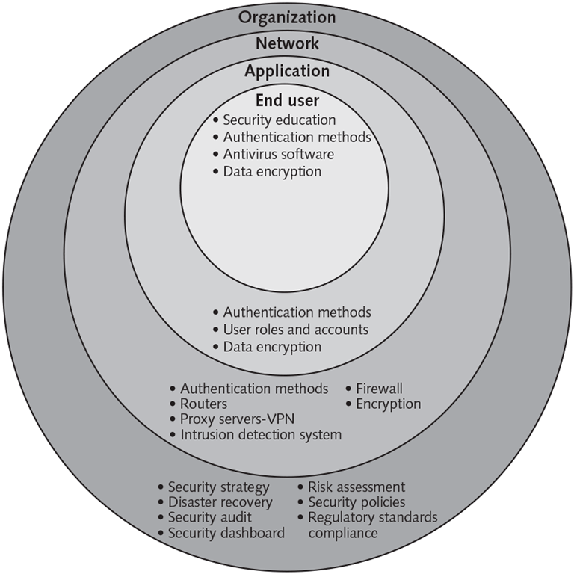
Implementing CIA security

Slide 16
Implementing CIA at the Organization Level
Implementing CIA requires a risk-based security strategy with an active governance process and a well-defined disaster-recovery plan.
Risk assessment: The process of assessing security-related risks to an organization’s computers and networks from both internal and external threats
A completed risk assessment identifies the biggest threats to a company and helps focus security efforts on the areas of highest payoff

Slide 17
General Risk Assessment Process
Step | Description
1 | Identify the set of IT assets of most concern.
2 | Identify the loss events or the risks/threats that could occur.
3 | Assess the frequency of events or the likelihood of each potential threat.
4 | Determine the impact of each threat occurring.
5 | Determine how each threat can be mitigated.
6 | Assess the feasibility of implementing the mitigation options.
7 | Perform a cost-benefit analysis to ensure that your efforts will be cost effective.
8 | Decide whether or not to implement a countermeasure.

Slide 18
Disaster Recovery
Disaster recovery plan: A documented process for recovering an organization’s business information system assets—including hardware, software, data, networks, and facilities—in the event of a disaster
Mission-critical processes: Business processes that are more pivotal to continued operations and goal attainment than others

Slide 19
Security Policies and Security Audits
Security policy: A policy that defines an organization’s security requirements, as well as the controls and sanctions needed to meet those requirements
A good security policy delineates responsibilities and the behavior expected of members of the organization.
Security audit: An audit that evaluates whether an organization has a well-considered security policy in place and if it is being followed

Slide 20
Regulatory Standards Compliance
An organization may be required to comply with external standards; examples include:
Bank Secrecy Law of 1970
Requires financial institutions in the United States to assist U.S. government agencies in detecting and preventing money laundering
Federal Information Security Management Act
Requires every federal agency to provide information security for the data and information systems that support the agency’s operations and assets
Health Insurance Portability and Accountability Act
Regulates the use and disclosure of an individual’s health information

Slide 21
Security Dashboards
Security dashboard software
Provides a comprehensive display of all key performance indicators related to an organization’s security defenses, including:
Threats
Exposures
Policy compliance
Incident alerts
Reduces the effort required to monitor, identify and respond to threats

Slide 22
Implementing CIA at the Network Level
Authentication methods
An organization must authenticate users attempting to access its network
Username and password
Smart card and a PIN
Fingerprint
Voice pattern sample
Retina scan
Multifactor authentication schemes include:
Biometrics
One-time passwords
Hardware tokens that plug into a USB port and generate a password

Slide 23
Firewalls & Routers
Firewall: A system of software and/or hardware that stands guard between an organization’s internal network and the Internet
Next-generation firewall (NGFW): A hardware- or software-based network security system that blocks attacks by filtering network traffic based on packet contents
Router: A networking device that connects multiple networks and transmits data packets between networks
Allows you to:
Create a secure network by assigning it a passphrase
Specify a unique media access control (MAC) address for each legitimate device connected to the network and prevent access by any other device

Slide 24
Encryption
Encryption: The process of scrambling messages or data in such a way that only authorized parties can read it
Encryption key: A value that is applied to unencrypted text to produce encrypted text that is unreadable by those without the encryption key
Two types of encryption algorithms:
Symmetric and asymmetric
Transport Layer Security (TLS): A communications protocol that ensures privacy between communicating applications and their users on the Internet
TLS enables a client (e.g., a web browser) to initiate a temporary private conversation with a server

Slide 25
Proxy Servers and Virtual Private Networks
Proxy server: Acts as an intermediary between a web browser and another server on the Internet
You enter the URL for a website into your browser.
The request is forwarded to the proxy server, which relays the request to the server where the website is hosted.
The web page is returned to the proxy server, which then passes it on to you.
Result: The website sees the proxy server as the actual visitor and not you.
Virtual private network (VPN): Enables remote users to securely access an organization’s computing resources and share data by transmitting and receiving encrypted data over public networks, such as the Internet

Slide 26
Intrusion Detection System
Intrusion detection system (IDS): Software and/or hardware that monitors system resources and activities and issues an alert when it detects network traffic attempting to circumvent security measures
Two approaches to intrusion detection:
Knowledge-based: Contains information about specific attacks and system vulnerabilities and watches for attempts to exploit these vulnerabilities (e.g., repeated failed login attempts).
Behavior-based: Models normal behavior of a system and its users based on reference information; compares current activity to this model, looking for deviations (e.g., unusual traffic at odd hours)

Slide 27
Implementing CIA at the Application Level
Authentication methods
Single-factor: Requires only one credential (e.g., a password)
Two-factor: Requires two types of credentials (e.g., a bank card and a PIN)
User roles and accounts
Used to give users authority to perform their responsibilities within an application and nothing more
Data encryption
Protects data being used within an application from unauthorized access

Slide 28
Implementing CIA at the End-User-Level
Security education
Educate end users about the importance of security so they are motivated to understand and follow security policies.
Authentication methods
Require end users to implement a security passcode that must be entered before their device accepts further input.
Antivirus software
Virus signature: A specific sequence of bytes that indicates the presence of a previously identified virus
Data encryption
Full-disk encryption protects storage devices and/or hard drives so they cannot be removed from a computer and plugged into another computing device

Slide 29
Response to Cyberattack
An organization should be prepared for the worst—a successful attack that defeats all or some of a system’s defenses and damages data and information systems.
In a security incident, the primary goal must be to regain control and limit damage, not to attempt to monitor or catch an intruder.
A well-developed response plan helps keep an incident under technical and emotional control.

Slide 30
Incident Notification
A key element of any response plan is to define who to notify and who not to notify in the event of a computer security incident.
Questions to cover include:
Within the company, who needs to be notified, and what information does each person need to have?
Under what conditions should the company contact major customers and suppliers?
How does the company inform them of a disruption in business without unnecessarily alarming them?
When should local authorities or the FBI be contacted?

Slide 31
Protection of Evidence and Activity Logs
An organization should document all details of a security incident as it works to resolve a security incident.
Capture all system events, the specific actions taken (what, when, and who), and all external conversations (what, when, and who) in a logbook.

Slide 32
Eradication and Incident Follow-Up
Eradication
Before the IT security group begins eradication efforts, it must collect and log all possible criminal evidence and then verify all backups are current, complete, and free of malware.
Incident Follow-Up
An essential part of follow-up is to determine how the organization’s security was compromised so that it does not happen again.
A formal incident report includes a detailed chronology of events and the impact of the incident.

Slide 33
Using an MSSP
Managed security service provider (MSSP): A company that monitors, manages, and maintains computer and network security for other organizations.
Many small and midsized organizations use an MSSP because the level of in-house network security expertise needed to protect their business operations is too costly to acquire and maintain.

Slide 34
Computer Forensics
Computer forensics: Combines elements of law and computer science to collect, examine, and preserve data from computer devices and networks in a manner that preserves the integrity of the data gathered so it is admissible as evidence in court.
Proper handling of a computer forensics investigation is the key to fighting computer crime successfully in court.

Slide 35
Summary, Part 1
Why are computer incidents so prevalent, and what are their effects?
Reasons include:
Increasing computing complexity
Expanding and changing systems
An increase in the prevalence of BYOD policies
A growing reliance on software with known vulnerabilities
Increasing sophistication of those who would do harm
Exploit: An attack on an information system that takes advantage of a particular system vulnerability (often a result of poor system design or implementation)

Slide 36
Summary, Part 2
Why are computer incidents so prevalent, and what are their effects?
Perpetrators of computer crime:
Black hat hacker
Cracker
Malicious insider
Industrial spy
Cybercriminal
Hacktivist
Cyberterrorist
White hat hacker: Hired by an organization to test the security of its information systems allowing the organization to improve its defenses

Slide 37
Summary, Part 3
Why are computer incidents so prevalent, and what are their effects?
Common computer exploits:
Ransomware, viruses, and worms
Trojan horses
Logic bombs
Blended threats
Spam
DDoS attacks and rootkits
Advanced persistent threats
Phishing, spear phishing, smishing, and vishing
Cyberespionage and cyberterrorism

Slide 38
Summary, Part 4
Why are computer incidents so prevalent, and what are their effects?
Department of Homeland Security (DHS): Federal agency with the responsibility to provide for a “safer, more secure America, which is resilient against terrorism and other potential threats.”
Office of Cybersecurity and Communications is responsible for enhancing the security, resilience, and reliability of U.S. cyber- and communications infrastructure
US-CERT: A partnership between DHS and the public and private sectors established to protect the nation’s Internet infrastructure against cyberattacks

Slide 39
Summary, Part 5
Why are computer incidents so prevalent, and what are their effects?
Laws enacted to combat computer-related crime:
Computer Fraud and Abuse Act
Fraud and Related Activity in Connection with Access Devices Statute
Stored Wire and Electronic Communications and Transactional Records Access Statutes
USA Patriot Act

Slide 40
Summary, Part 6
What can be done to implement a strong security program to prevent cyberattacks?
CIA security triad: Confidentiality, integrity, and availability of IT resources and data
An organization’s security strategy must include security measures at the organization, network, application, and end-user levels

Slide 41
Summary, Part 7
What can be done to implement a strong security program to prevent cyberattacks?
Key elements of a risk-based security strategy:
A risk assessment to identify and prioritize threats
A well-defined disaster recovery plan that ensures the availability of key data and information technology assets
Definition of security policies to guide employees to follow recommended processes and practices
Periodic security audits to ensure end users are following established policies and to assess adequacy of security policies
Compliance standards defined by external parties
Use of a security dashboard to track key performance indicators

Slide 42
Summary, Part 8
What can be done to implement a strong security program to prevent cyberattacks?
Reasonable assurance: Manager’s must use their judgment to ensure that the cost of control does not exceed the system’s benefits or the risks involved
Network security layer—key elements: Authentication methods, a firewall, routers, encryption, proxy servers, VPN, and an IDS
Application security layer—key elements: Authentication methods, user roles and accounts, and data encryption
End-user security layer—key elements: Security education, authentication methods, antivirus software, and data encryption

Slide 43
Summary, Part 9
What actions must be taken in the event of a successful security intrusion?
A response plan must be developed well in advance of any incident, and should address:
Notification
Protection of evidence and activity logs
Containment
Eradication
Follow-up
Organizations must implement fixes against well-known vulnerabilities and conduct periodic IT security audits

Slide 44
Summary, Part 10
What actions must be taken in the event of a successful security intrusion?
Many organizations use a managed security service provider (MSSP) to monitor, manage, and maintain their computer and network security
Experts trained in computer forensics collect, examine, and preserve data from computer devices and networks, in a manner that preserves the integrity of the data so it is admissible as evidence in a court of law.

